Slide 1
Urantia Book Community Survey
David Schlundt
Presentation to the Urantia Foundation
April 17, 2020
David.Schlundt@urantiabook.org

Slide 2

Background
It has been 65 years since the publication of the Urantia Book.
Much has changed in that time culturally and technologically.
It is time to engage in some self-study, brainstorming, and to develop plans for how the Urantia Brotherhood will carry out its mission in the 21st century.
Same set of problems that face all the Urantia Book organizations

Slide 3
Questions
What can we do to expand and enhance the Urantia Book Fellowship’s (UBF) digital outreach?
How can we reach out to emerging communities of Urantia Book readers?
How can we better attract and meet the needs of young people?
What are the needs of members of existing societies and study groups and are there any unmet needs we can address?
Are there new forms of community that would be viable? Can we identify new models that will create learning and interpersonal bonding that the study groups have historically created but do not involve face-to-face small group meetings?

Slide 4
Questions
In addition to serving existing readers, are there strategies we should identify and implement to create new readers? Who is open to finding the Urantia book and how do we reach out to these people?
Spiritually motivated truth-seekers have ways to discover the Urantia book through personal contact or online. How do we appeal to core secular audiences such as artists, scientists, philosophers, businesspeople, people in government, the not-for-profit human services, and others? While they may not be actively seeking spiritual truths, they may in fact be open to these truths if approached in the right way.
Are there ways to work the core beliefs and values of the Urantia Book into communications that do not mention the Urantia Book? Is this a pathway for education, outreach, service to humanity?

Slide 5

Three Step Plan
Online reader survey
Delphi process with the general council to build consensus
Follow up with focus groups
  Existing study groups
  Young readers
This presentation summarizes what we learned from steps one and two

Slide 6
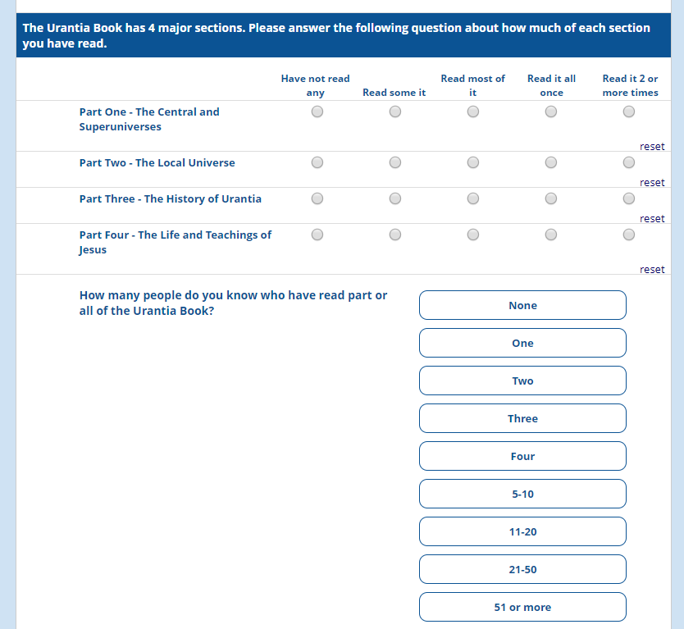
The survey
Online survey using REDcap
Reviewed by the Ad Hoc committee
Reviewed by the executive committee
Two main sections of the survey:
  Participant characteristics
  Reader needs

Slide 7
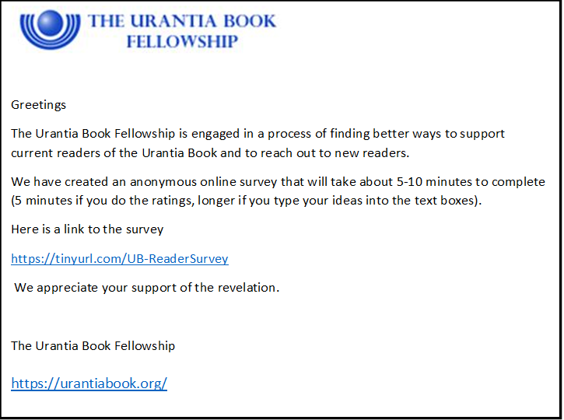
Survey Distribution
The primary source of participants was the Urantia Book Fellowship’s email list. This list has 7000+ email addresses in it. The following text was sent:

Slide 8
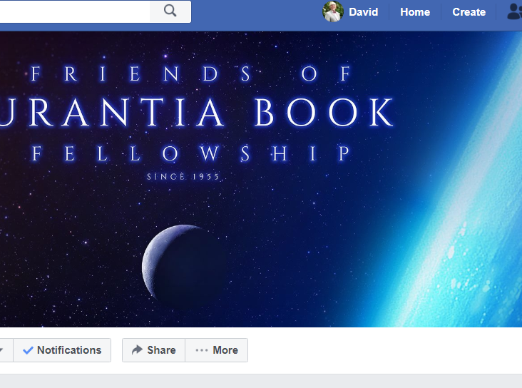
Survey Distribution
The email was sent out to the list on two occasions (01/14/2020 and 01/28/2020).
In addition, the survey request was posted to social media 2 times. The social media sites used included the Urantia FaceBook page, and the Friends of the Urantia Book Fellowship FaceBook page, both on January 27, 2020.
777 Completed surveys

Slide 9

The results
Characteristics of the participants
Comparison of younger (50 under) vs. older (51 and older) participants
Comparison of American to international participants
Reader needs
  Younger vs. older
  American vs. International
  Analysis of free text responses

Slide 10
Young people were sparse
0.1% 25 & under
1.3% 30 & under
4.4% 35 & under
6.3% 40 & under
Many will graduate to the mansion worlds in the next 20 years

Slide 11
Relatively well-educated participants
64% have college degrees

Slide 12
Unusual to have more males than females volunteer to participate in an online survey

Slide 13
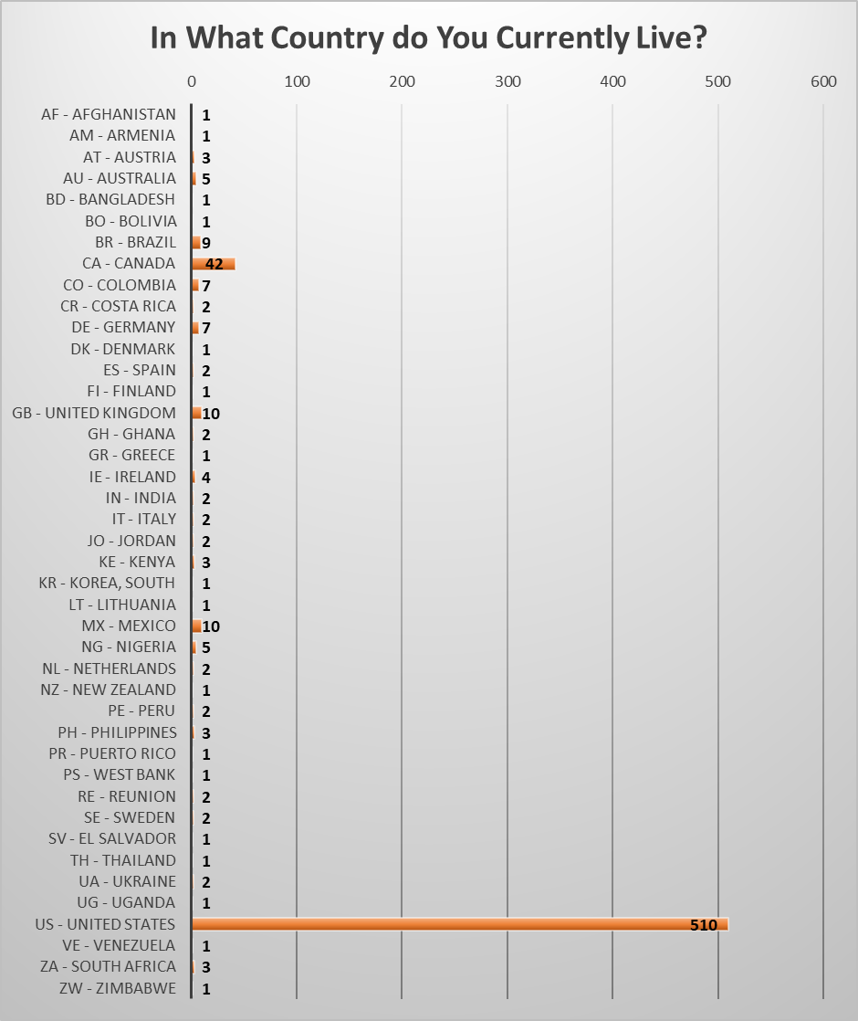
By far, most were from the United States. Many other nations represented in relatively small numbers.

Slide 14
66% were from the United States
19% Identified being from a country other than the US
15% did not answer this question

Slide 15
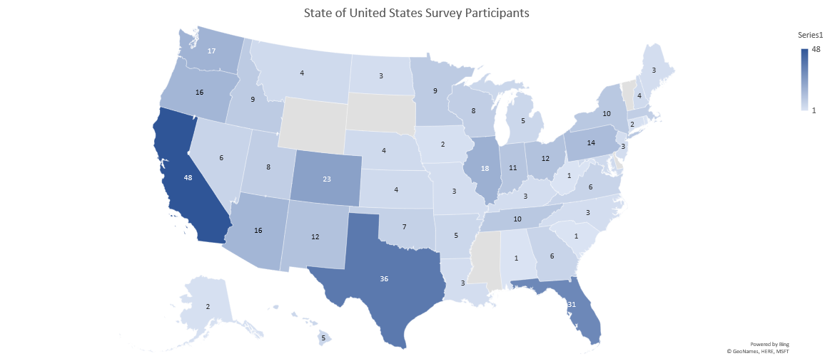
n=407

Slide 16
Over half of the participants reported more than 20-year history with the Urantia Book and
68 percent had more than 10 year history.
Thirty percent of the respondents had ten years or less experience with the Urantia Book.

Slide 17
Wide range of ages
1% are not appropriately labeled Urantia Book readers
Many started in their 20’s

Slide 18
Part 1 gets read the least
Part 4 gets read the most
More than half of the sample has read the book 2 or more times

Slide 19
14% of the participants do not know anyone else
38% Know 4 or fewer people
Wide range in the degree to which participants have access to others who are familiar with the Urantia Book
Suggests are real need for building new communities

Slide 20
46% have 5 or fewer experiences with a study group
36% have extensive experience
Suggest that alternatives to in person study groups may be a way to build new communities

Slide 21
Differences between American and International
Americans (78%-4%) and unknown (83%-0%) and international (48%-10%) were 61+ vs 35 or less.
Americas fewer with HS degree, unknown more with HS degree
Americans had better representation from women (Male: A=62%, I=76%, U=74%)
More international less than 1-year (A=3%, I=10%. U=6%)
More American 21 years and more (A=62%, I=35%, U=58%)
International less likely to have read parts 1-3
Unknown more likely to have read less than once.
More international participants did not know any UB readers (A=13%, I=20%, U=14%)
More international participants had never attended a study group (A=29%, I=46%, U=33%)
More American participated in 51 or more study groups (A=40%. I=22%, U=35%)
International participants were somewhat younger and less experienced with reading the book and attending study groups

Slide 22
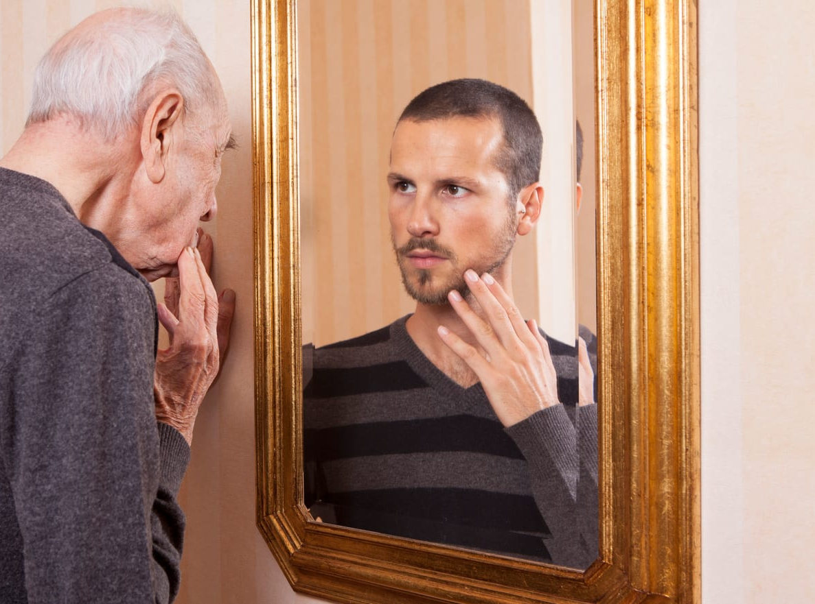
Differences Between Younger* (n=106) and Older (n=667)
More younger (50 and younger) from non-English speaking countries
More younger readers had 10 years or less experience (33% vs. 17%)
More older (51 +) had 21 or more years (68% vs. 18%)
No difference in study group experience
Older read Urantia book more times
* This is the AARP definition of a younger person

Slide 23
Both old and young use a range of websites.
Urantia Foundation
Urantia Book Fellowship
Truthbook are the most used
Total of 58 websites I could locate

Slide 24
Some interesting age differences in Facebook use
51 total Facebook pages I was able to find given the description
Facebook appears to be a hot spot, especially for younger people

Slide 25
Not as commonly used as websites and Facebook as online Urantia Book resources.
Total of 15 sites I was able to verify

Slide 26

Questions?

Slide 27
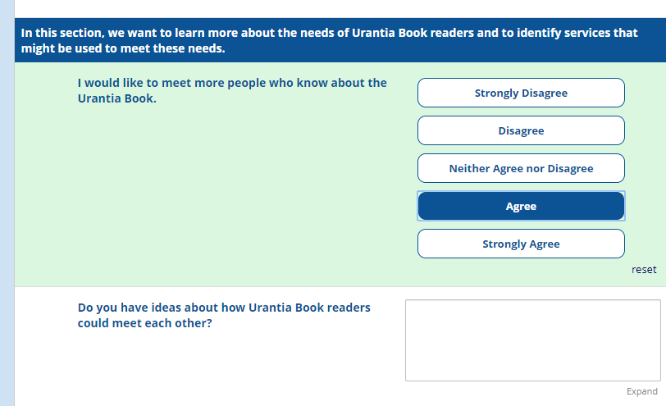
Perceptions and Needs of Survey Participants
Quantitative Ratings - Graphs
Qualitative Free-text responses
  Categorized into themes

Slide 28
Eighty percent of the participants agreed or strongly agreed with this statement.
Only 3% disagreed or strongly disagreed.
There was a significant age difference with younger participants more often selecting strongly agree.

Slide 29
Do you have ideas about how Urantia Book readers could meet each other?
Conferences | Forums and Chats
Places | Social Media
Local Marketing | Events
Study Groups | Reflections
Online Study Groups | System changes
Databases | Subtle
Zoom | Use of Media
Apps that connect people

Slide 30
Overall, 25% were already participating in study group.
Another 46% agreed or strongly agreed with this statement.
Only 8% disagree or strongly disagreed with the statement.
Older participants were more likely to choose the neither agree nor disagree option.
Younger participants were more likely to agree or strongly agree than older participants.
This item shows that there is a strong interest in face-to-face study groups.

Slide 31
In what ways would participating in a study group enhance your experience of reading the Urantia Book?
Study Group Conduct | Outreach to Others
Personal Spiritual Growth | Reflections
Personal Intellectual Growth | Social Good

Slide 32
Overall, 54% of the respondents chose agree of strongly agree.
Younger readers more often agreed (40% vs. 30%) or strongly agreed (37% vs. 20%).
Thirty-six percent of the sample choose neither agree nor disagree, but it was a much more common choice of older readers (39% vs. 17%).
There were not very many (10%) who disagreed with this statement.
Overall, there was strong interest in coming together for activities other than study groups, especially for younger participants.

Slide 33
What kinds of group activities would be interesting to you?
Social Events | Outreach to Others
Outdoor Activities | Meetings/Conferences
Religious/Spiritual activities | Create New Institutions

Slide 34
Overall, 52% agreed or strongly agreed with this item.
Fewer older participants strongly agreed (12% vs. 24%).
The older participants were far more likely to choose neither agree nor disagree (42% vs, 24%).
Overall, 17% selected disagree or strongly disagree.
Compared to in person study groups, there was more disagreement and ambivalence.
Yet, over half of the participants had an interest in online study groups.

Slide 35
I am interested in participating in an online Urantia Book Study group.
Leadership | Planning
Type of Digital Platform | Timing
Format | Reflections

Slide 36
Overall, 48% of the participants agreed or strongly agreed with this item.
The younger participants were more likely to strongly agree (19% vs. 10%) and were less like to pick neither agree nor disagree (37% vs 56%).
Overall, only 9% disagreed or strongly disagreed with this item.
Good support for this, especially among younger participants

Slide 37
Describe the kinds of online resources that you wish existed for Urantia Book readers
International Resources | Importance of High-Quality Resources
Tools to Study the Urantia Book | Appeal to Younger People
Secondary Works that Expand on the UB | Specific Interest Groups
History or the UB | More UB and Science
Guidance on Living the Teachings | Courses on UB topics

Slide 38
Overall, 43% agreed or strongly agreed with this statement.
More participants (47%) chose neither agree not disagree.
Only 10% of participants disagreed with this statement.
Younger readers were more likely to disagree (13% vs 7%), less likely to choose neither agree nor disagree (31% vs 49%) and more likely to strongly agree (22% vs 10%).
There were mixed opinions on this item, but the creation of new printed material may very well meet the needs of a large number of Urantia Book readers.

Slide 39
Describe the kinds of printed materials you would find interesting or useful as a Urantia Book reader
Close Gap Between Science and Religion | Materials for Children
Promote Spiritual Growth | Translation of Secondary Works
Types (Books, Magazines, etc.) | UB concepts presented more simply
History or the UB | Guidance on Living the Teachings

Slide 40
Overall, 59% of participants agreed or strongly agreed with this statement.
The younger participants were more likely to strongly agree (30% vs. 21%).
Thirty-five percent choose neither agree nor disagree,
Only 6% disagreeing with this statement.
There is a range of enthusiasm for more efforts to disseminate the Urantia Book, but very little opposition

Slide 41
What ideas do you have about ways to disseminate the Urantia Book?
Books | Local Events
Movies | National and International Events
Television | Churches
Marketing | Universities
Institutional Outreach | Personal Outreach

Slide 42
Thirty-one percent of the participants agreed or strongly agreed with this item.
Thirty-nine percent choose neither agree nor disagree
30 percent choosing disagree or strongly disagree.
There were no age differences in response to this question.
Not a strong consensus but the quotes are interesting.

Slide 43
What concepts in the Urantia book do you think will generate the most resistance?
Race and Eugenics | God and the Superuniverse
Life of Jesus | Origin of the Urantia Book
Ideas that Conflict with Christianity | Sexism

Slide 44
Delphi Process
Consensus Building Exercise
Multi-day process at the February General Council Meeting
Started with the results of the survey
Worked on Setting Priorities
Considered Specific Strategies

Slide 45
Digital/Web Outreach
Zone Connection App
Essential Functions:
Increase knowledge
Social networks
Spiritual growth
Disseminate
Personal interaction
Person to Person Outreach
Create study groups
UB Fellowship
Urantiabook.org
Virtual study groups
Activists
Study Groups
UBF registered
Organizers
Digital content
Experienced Readers
Know about the UB
Active spiritual seekers
Conference Events
Potentially interested
Outreach social media
Ready to change
Secondary works
Unlikely to be changed
Hierarchy
of Communities
Definitely not

